Slide 1
StackEmUp
Idea / Approach Details
Problem Statement : New Education Policy
Team Name : BitWiz
Team Leader Name : Aditya Vadalkar
Team Members : Tanmay Jain
Satvik Dalvi
Vaibhav Pallod

Slide 2
Effectiveness of idea
Visual aids
- These are tools that help to make an issue or lesson clearer or easier to understand
Interactive objects in gaming world
- that creates interest
Players can experience and imbibe programming logic on their own
Caters to the youth
- decreases efforts towards education accessibility
Promotes experiential learning
- helps to immediately apply knowledge and creates real time coaching .
Gamification
- Gamification of education allows learners to take active roles in learning and develop technological skills.
Self learning
- when education becomes game-based, it motivates the students to complete their tasks

Slide 3

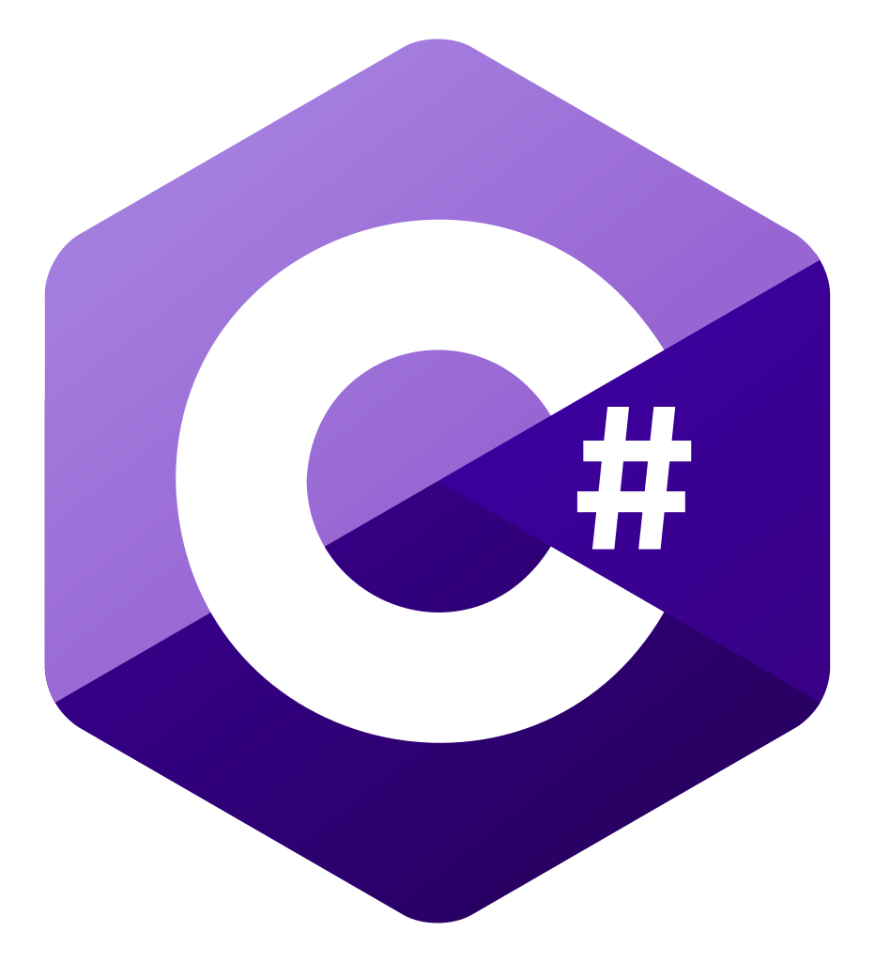


Technology Stack
Unity C#
Android SDK Github

Slide 4
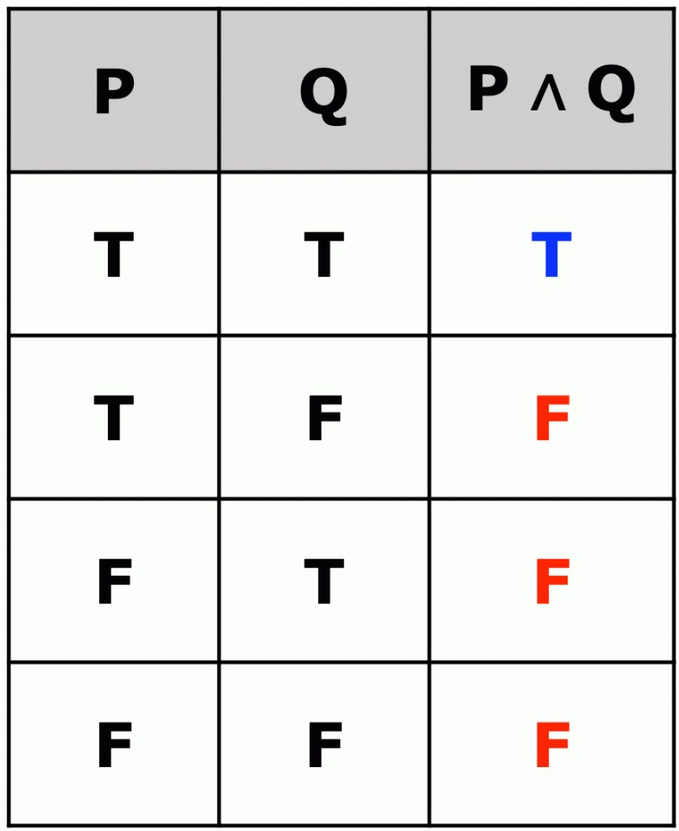
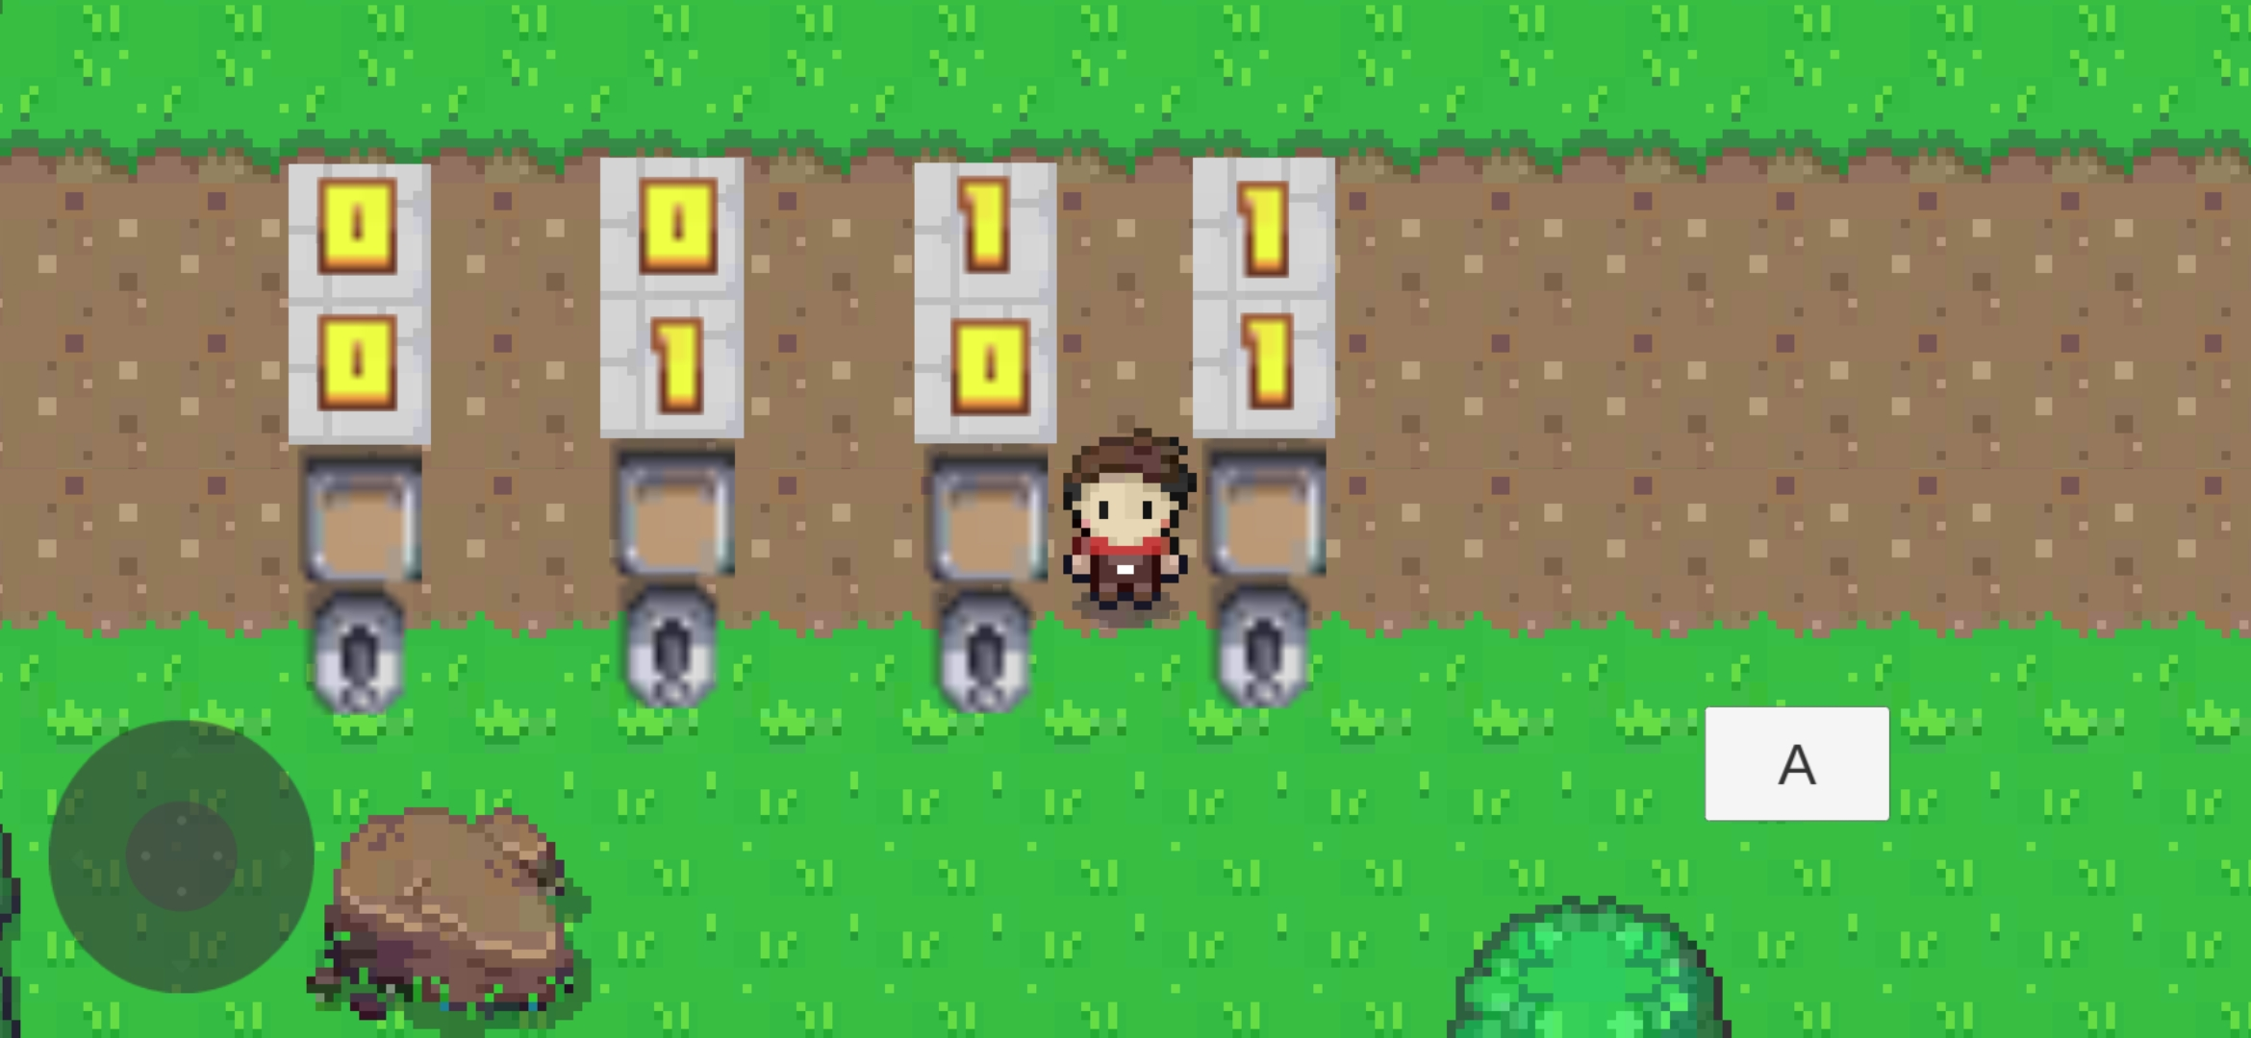
Images
Truth table we learn in school
Truth table we are teaching through game

Slide 5
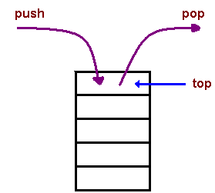
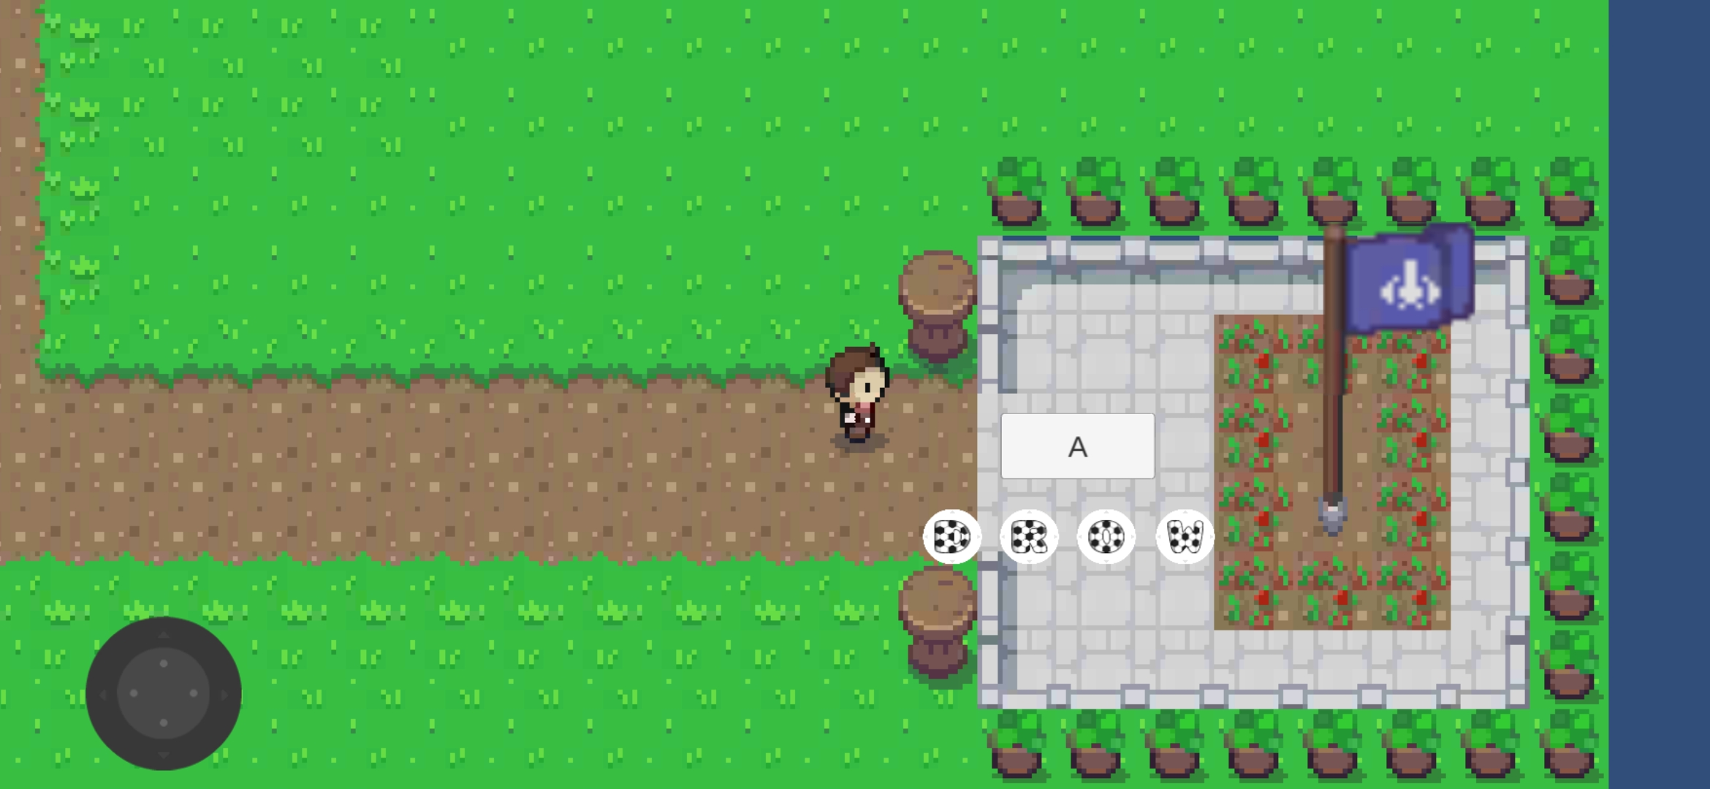
Images
Stack we learn in school
Stack concept we are teaching through game

Slide 6
Future Scope
Level designer – teachers can creates environments and scenarios using a level editor and other tools.
Build real world applications like Logic gates, Flipflops
Home learning

Slide 7


